Slide 1
Finding strongly-connected components
Plamen Pasliev
Luca Comoretto

Slide 2
Definition:
Considering a graph G = (V,E)
v, w vertices path-equivalent if Ǝ path from v to w and vice versa
Path equivalence partitions V into maximal disjoint sets called Strongly Connected Components (SCC)

Slide 3
Algorithms implemented:
Tarjan, implementing the pseudocode on Nuutila’s paper
Nuutila 1, Nuutila’s paper, can be found in «Other algorithms» folder on Github
Nuutila 2, Nuutila’s paper
Pearce 1, recursive version, «Other algorithms» folder on Github
Pearce 2, recursive version
The main versions of the algorithms can be found on Github at the following link:
https://github.com/plamenpasliev/StrongComponentsPaslievComoretto/

Slide 4
Tarjan
The algorithm works in the following way:
1. DFS search produces a DFS tree/forest
2. A root of a SCC is found, all descendants (which are not yet in a SCC) of the root are market as elements of this SCC
3. Second traversal of the graph is done using a stack. When the root is removed, all of the elements of that SCC are also removed from the stack

Slide 5
Nuutila 2
Reduces the second traversal, does not store all nodes on the stack
Stores only possible root nodes of nontrivial (containing at least one cycle) components on the stack.
Node x is a final candidate root if x=root[y] for some node y when all edges leaving y have been processed
Second traversal eliminated if graph is acyclic

Slide 6
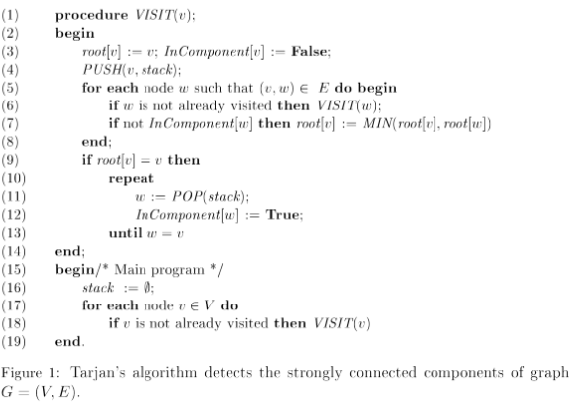
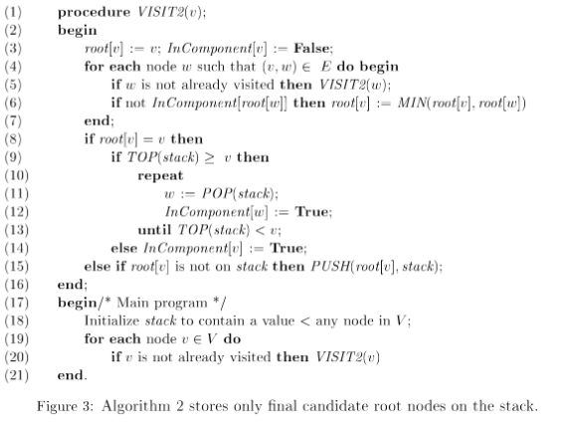
Tarjan versus Nuutila implementation:

Slide 7
Differences
- Running time of both is O(n+e)
- Number of nodes stored on the stack
Tarjan stores all n nodes on the stack
Nuutila implementation stores at most n-s nodes on the stack where s is the number of SCC
Important difference if the graph does not fit in main memory

Slide 8
Pearce 2
Improvements:
Condense information about local roots and visitation index
Index[v] and C inverted -> inComponent[v] removed
Rindex starting from 0 -> Visited[v] removed
Actual improvement in memory in imperative versions only
Notes:
Obiettivo è evitare che durante esplorazione, mentre
Piccolo problema se 2^w grandezza grafo V

Slide 9
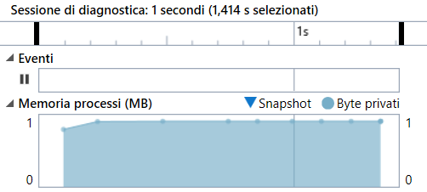
Tools for the analysis
Visual C++ Diagnostic Tool Debugger
Selecting in any point it is possible to see the exact memory allocation.
The calculations made keep track of the total memory allocation minus the initial one, in order to compute the memory required by the algorithm itself.

Slide 10
Performance: memory allocation
Expected allocation (V = #vertices, w = machine word size, E = #edges)
Tarjan: V(2+5w) bits
Nuutila: V(1+4w) bits
Pearce: V(1+3w) bits
Tested Configurations:
Random graphs – Circular graphs – Fully connected graphs, the last two cases in order to explore limit-cases and not only random ones.
Notes:
Say which tools used
Explain why these differences: - recursive - tools not precise in analizing memory - not good coding

Slide 11
Performance: actual memory (1)
Referring to github folder:
PerformanceTest.xsl provides the measures of the total memory allocation of the program for multiple cases of each of the algorithms (presented already)
NewPerformanceTest.xsl provides the measure of the memory allocated by the algorithm only, so what we are really interested to. The computation has been made 10 times for each of the graph conformation, changing the number of nodes and edges (The total is of 100 samples). The computation has been made on Pearce only, but with high quality and quantity.

Slide 12
Performance: actual memory (2)
Vertices | Edges | MemoryMean Kb
300 | 300 | 22.0
300 | 350 | 22.8
300 | 400 | 19.6
300 | 450 | 20.8
300 | 500 | 19.2
400 | 400 | 28.8
400 | 450 | 27.6
400 | 500 | 26.8
400 | 550 | 29.6
400 | 600 | 27.4
Mean300 | Mean400 | Ratio
20.88 | 28.04 | 0.74465
Taking in consideration all the possible uncertanties on the measures, the result is very interesting: the memory is stable when only E variates, while, with the increment of V, it changes proportionally to it, as the theory requires.

Slide 13
Performance: running time
Expected time: O(V+E)
Actual time: Very Different!
The times are quite consistent among the three algorithms
T proportional to V, but then holding V, decreases with E
For low V, Tarjan < Nuutila < Pearce
For high V, Pearce < Nuutila < Tarjan

